Slide 1
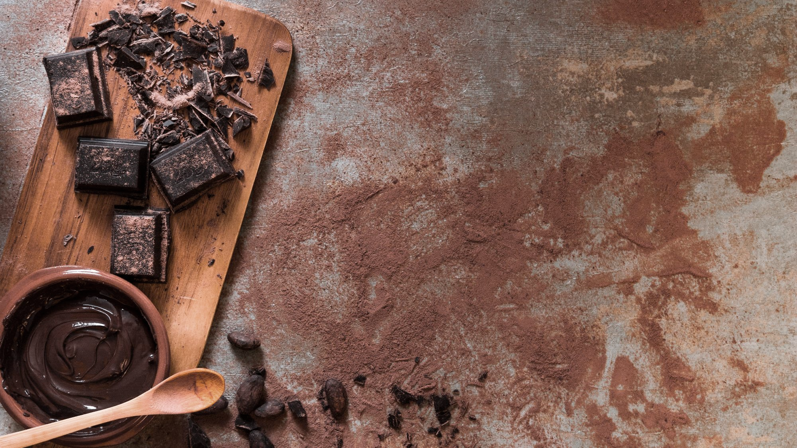
Machine Learning - Foundation
Term 3 Project – Candy Data Set
Gaurav Virmani
INSAID, March 2020 Cohort

Slide 2
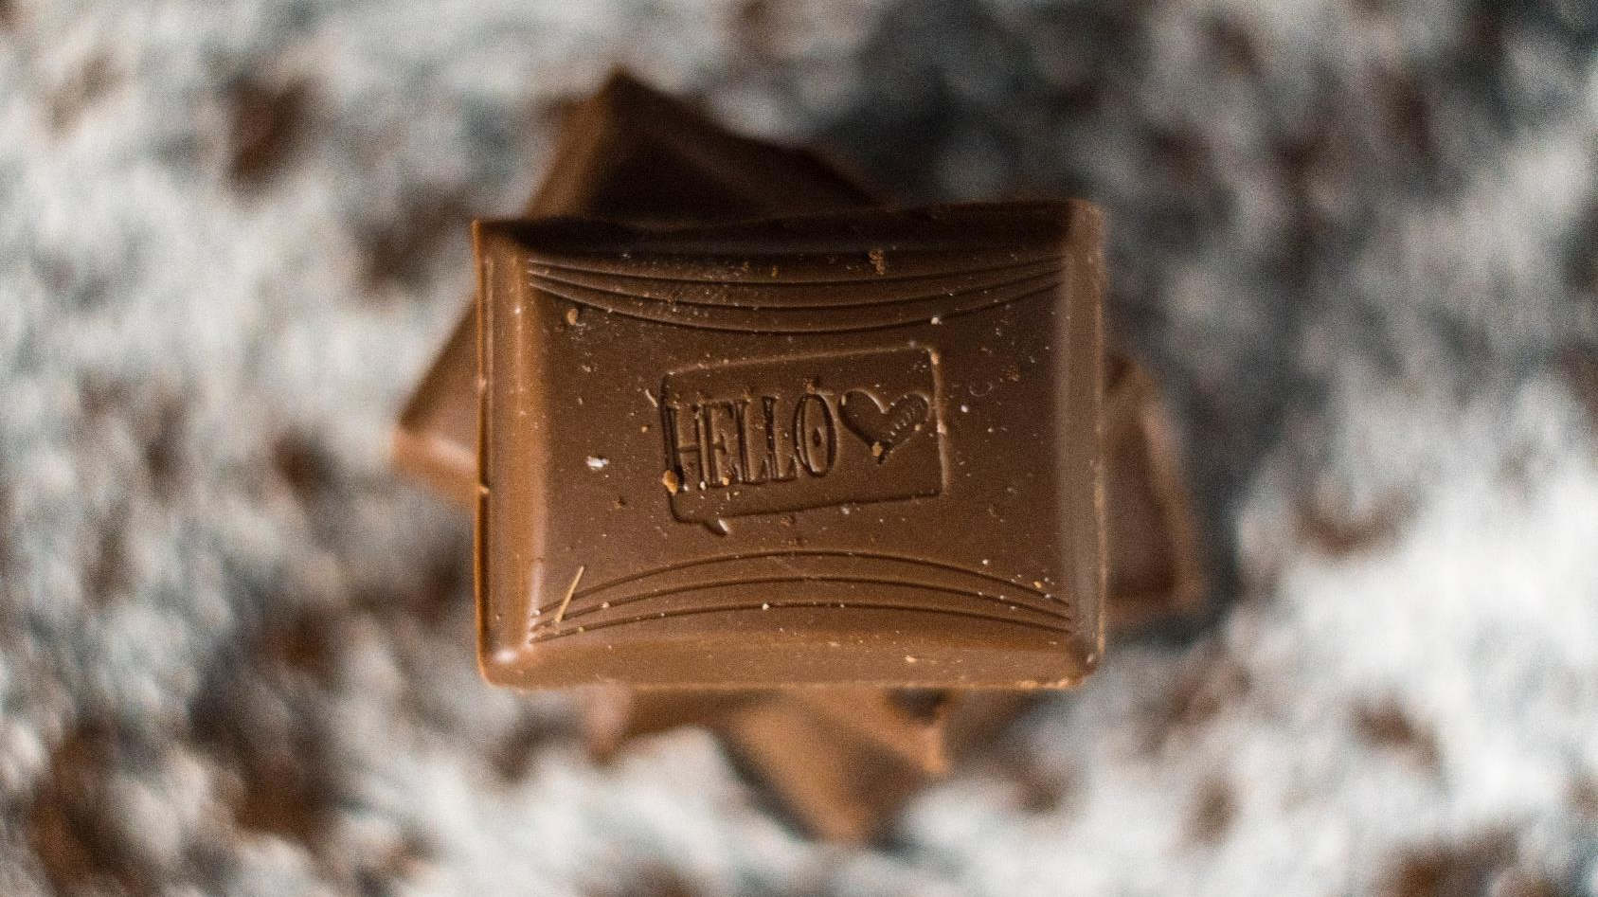
Dataset details
What is the best / least most popular Halloween candy? That was the question this dataset was collected to answer.
Data was collected where participants were shown presenting candies and asked to click on the one, they would prefer. After aggregating all the votes, each candy is given winpercent.
Background
Column Name | Description
competitorname | Name of the Candy
chocolate | Does it contain chocolate?
fruity | Is it fruit flavored?
caramel | Does it contain caramel?
peanutalmondy: | Does it contain peanuts, peanut butter or almonds?
nougat | Does it contain nougat?
crispedricewafer | Does it contain crisped rice, wafers or a cookie component?
hard | Is it a hard candy?
bar | Is it a candy bar?
pluribus | Is it one of many candies in a bag or box?
sugarpercent | The percentile of sugar it falls under within the data set
pricepercent | The unit price percentile compared to the rest of the set
winpercent | The overall win percentage according to 269,000 matchups
Variables

Slide 3
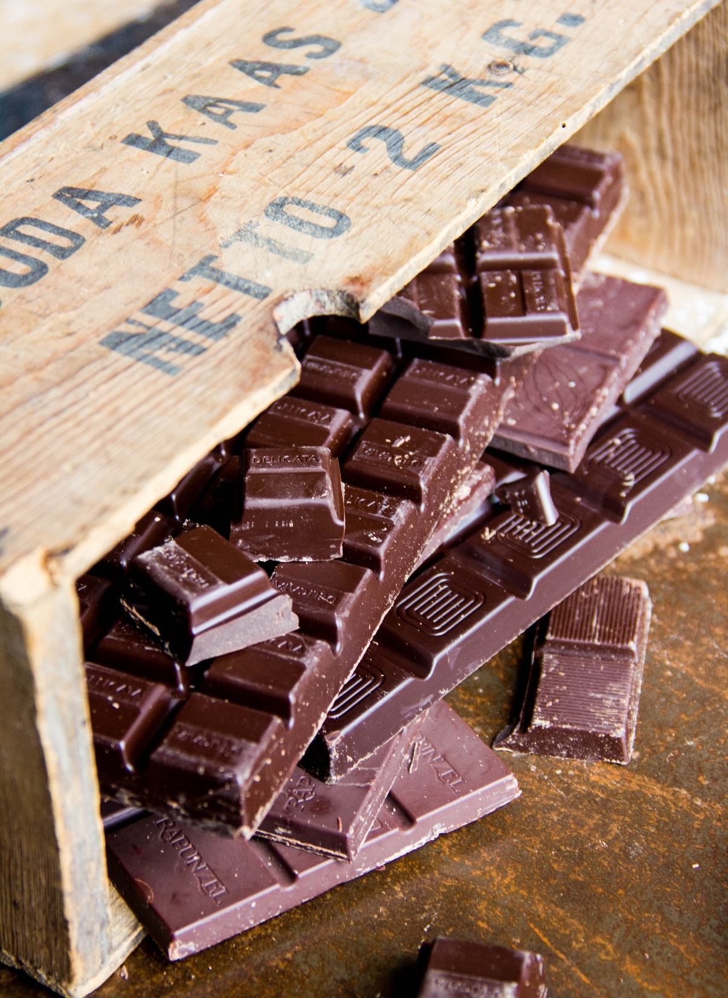
CONTENT FLOW
1.
Problem Statement
Defining the Problem Statement
2.
EDA
Exploratory Data Analysis of the dataset to gain insights
3.
Predictive Model
Identify, Build & Evaluate the Models
4.
Conclusion
Insights & Recommend the best Model

Slide 4
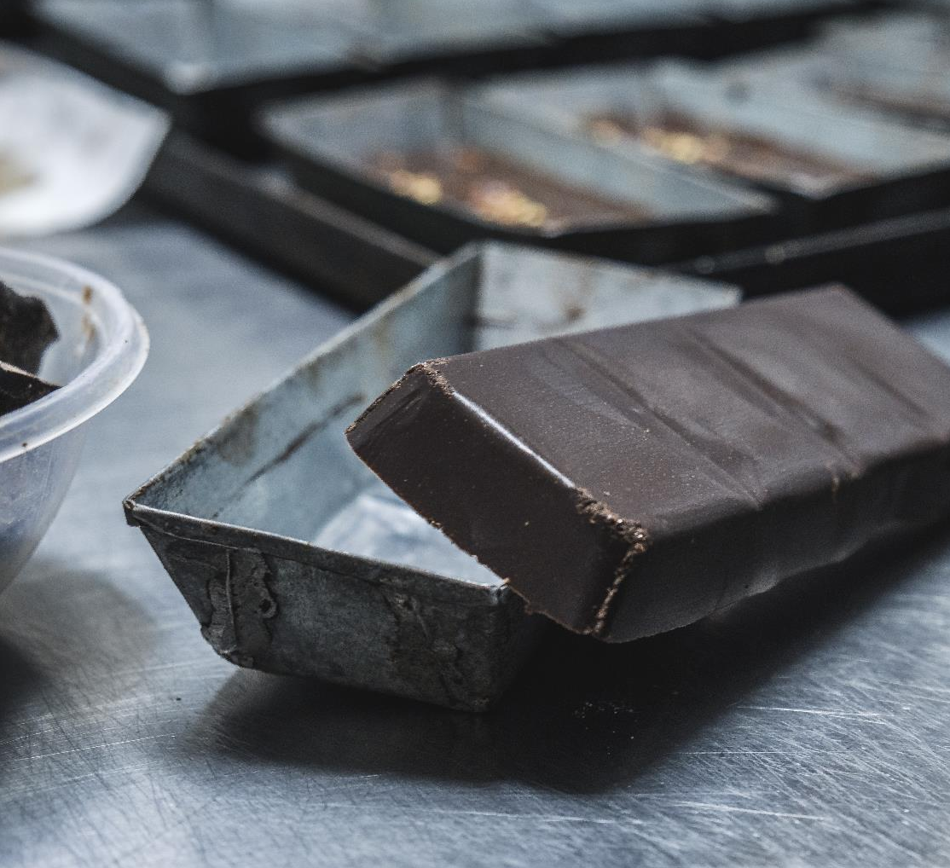
01
Identify the most / least popular candies
Problem Statement
02
Identify the variables that could impact the rankings
03
Predictive Modeling

Slide 5
CONTENT FLOW
1.
Problem Statement
Defining the Problem Statement
2.
EDA
Exploratory Data Analysis of the dataset to gain insights
3.
Predictive Model
Identify, Build & Evaluate the Models
4.
Conclusion
Insights & Recommend the best Model

Slide 6
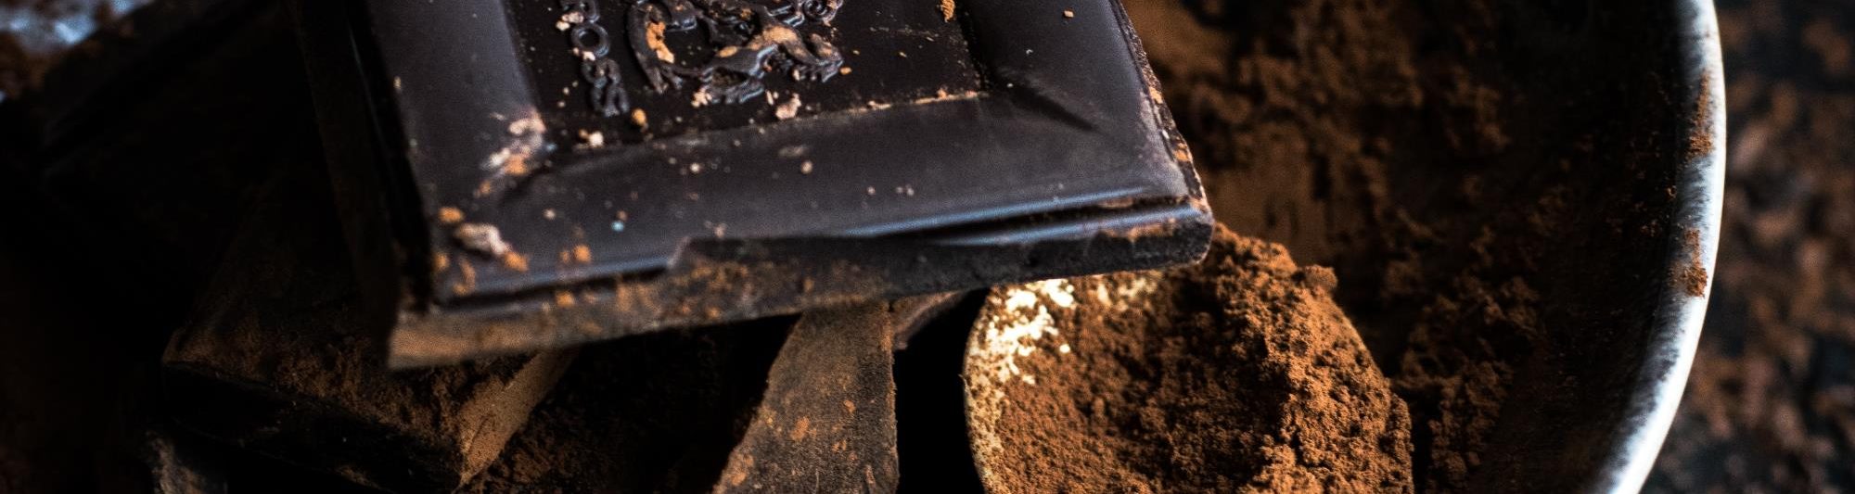
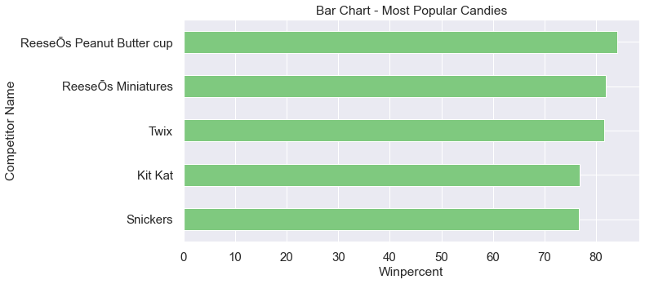
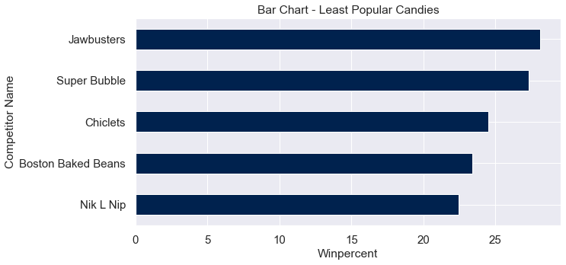
Which are the most & least popular candies?
Reese's Peanut Butter cup, Reese's Miniatures and Twix are the most popular candies
01
Least popular candies are Nik L Nip, Boston Baked Beans and Chiclets
03

Slide 7
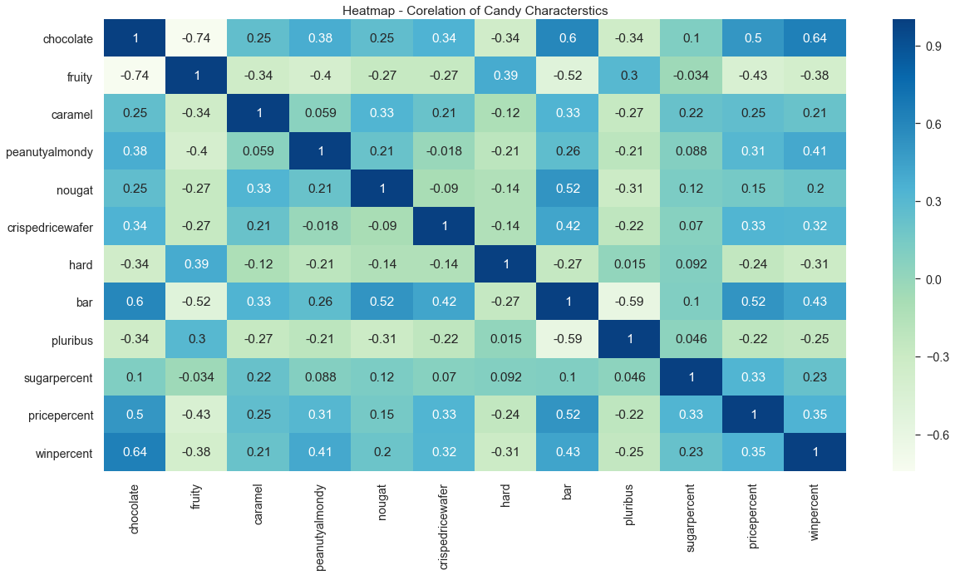
How candy characteristics are co-related?
01
High Win percentage candies contain Chocolate, followed by being a Bar and having Peanuts/Almonds
Popular candies are bit higher in Price and Sugar percentages
Chocolate is not found in fruity candies
Price of Chocolate or Bar candies are more while Fruity candies are least expensive
Fruity candies are hard as compared to the others
03

Slide 8
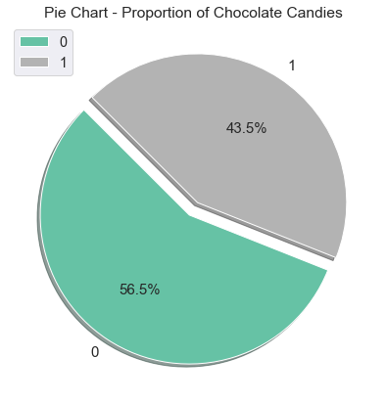
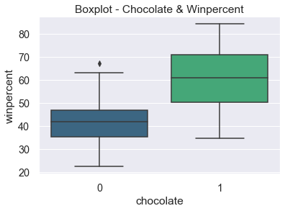
which characteristics impact win percentage?
03
43.5% of the candies contain Chocolate and have high win percentage

Slide 9
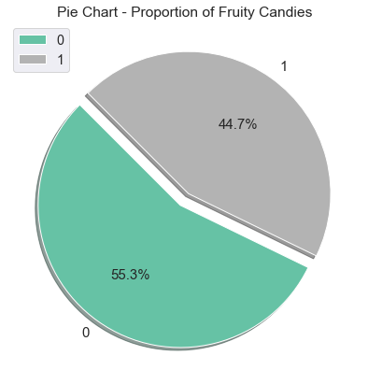
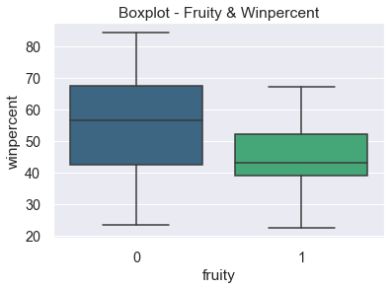
which characteristics impact win percentage?
03
45% of the candies have Fruity flavor but have low win percentage

Slide 10
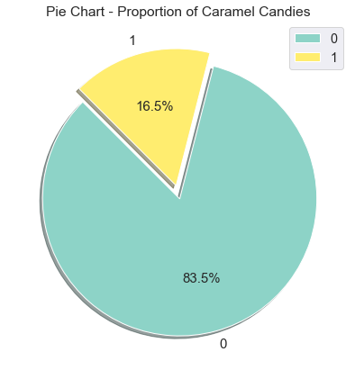
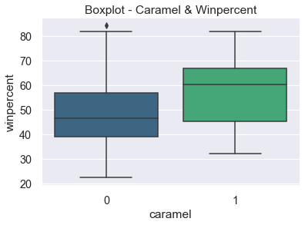
which characteristics impact win percentage?
03
Only 16.5% of the candies contain Caramel but have slightly higher win percentage

Slide 11
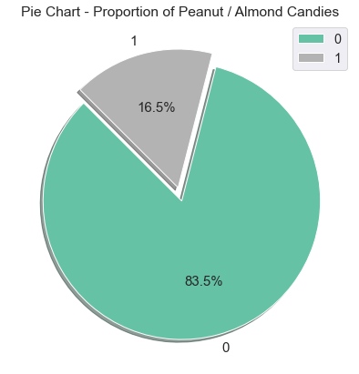
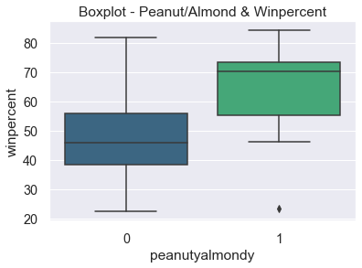
which characteristics impact win percentage?
03
Only 16.5% of the candies contain Peanuts / Almonds and effect win percentage

Slide 12
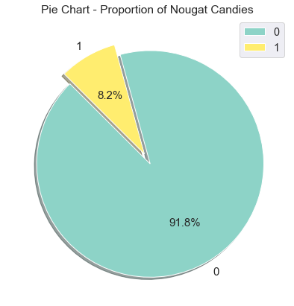
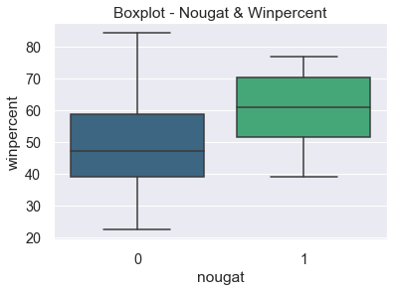
which characteristics impact win percentage?
03
Very less i.e. around 8% each are Nougat and Crisped Rice/Wafer candies. Also do not contribute much on the win percentage

Slide 13

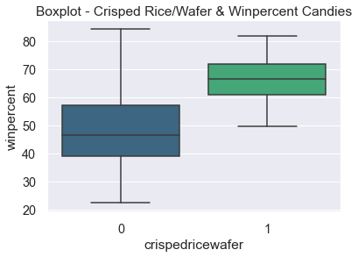
which characteristics impact win percentage?
03
Very less i.e. around 8% each are Nougat and Crisped Rice/Wafer candies. Also do not contribute much on the win percentage

Slide 14
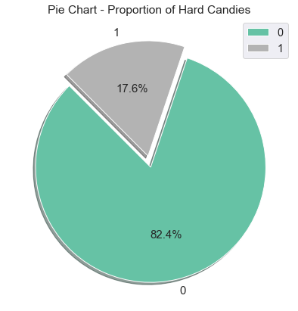
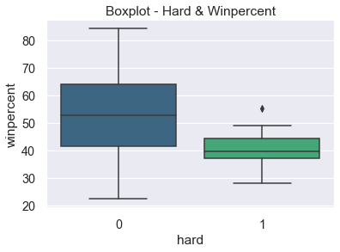
which characteristics impact win percentage?
03
Hard candies make up only 18% of the total candies and have a lower win percentage too

Slide 15
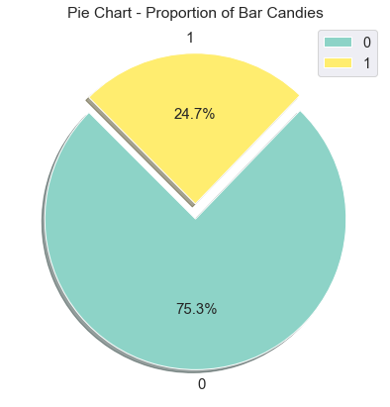
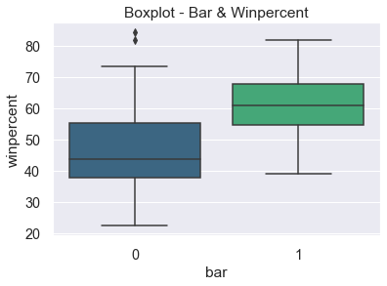
which characteristics impact win percentage?
03
Around 25% are Bar candies and contributes to high win percentage

Slide 16
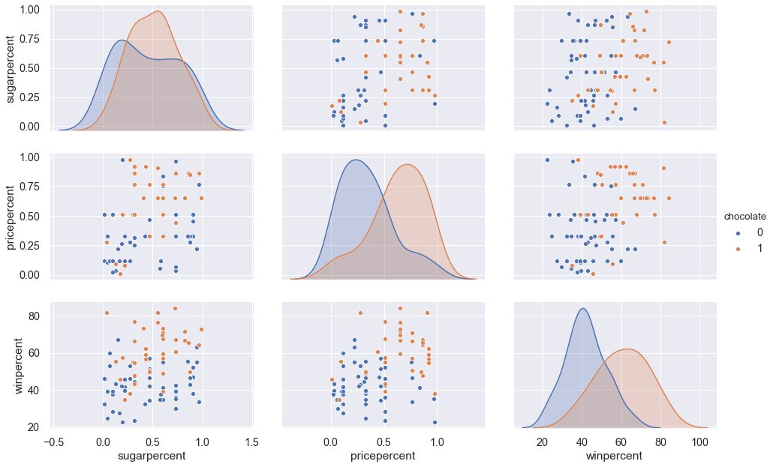
How candy characteristics co-related with sugar, price & win percentages?
03

Slide 17
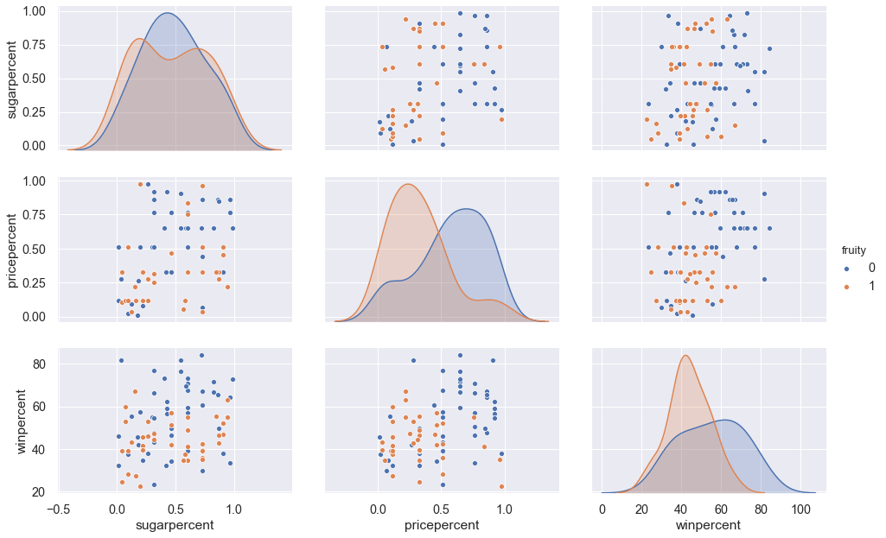
How candy characteristics co-related with sugar, price & win percentages?
03

Slide 18
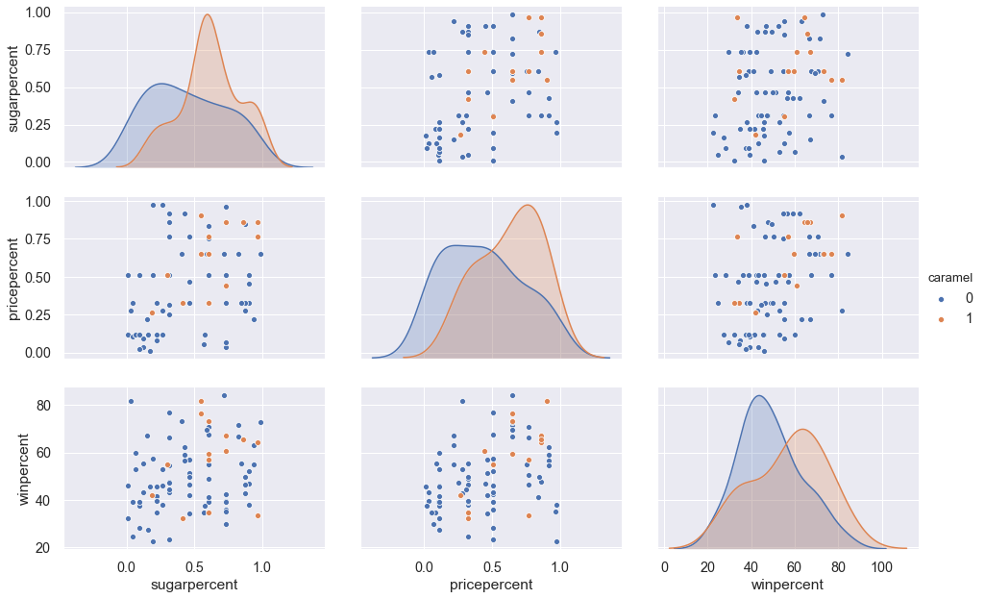
How candy characteristics co-related with sugar, price & win percentages?
03

Slide 19
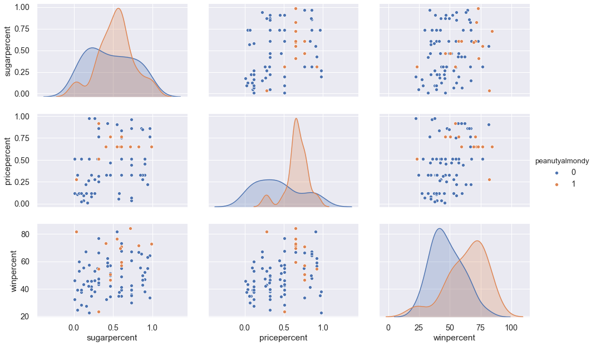
How candy characteristics co-related with sugar, price & win percentages?
03

Slide 20
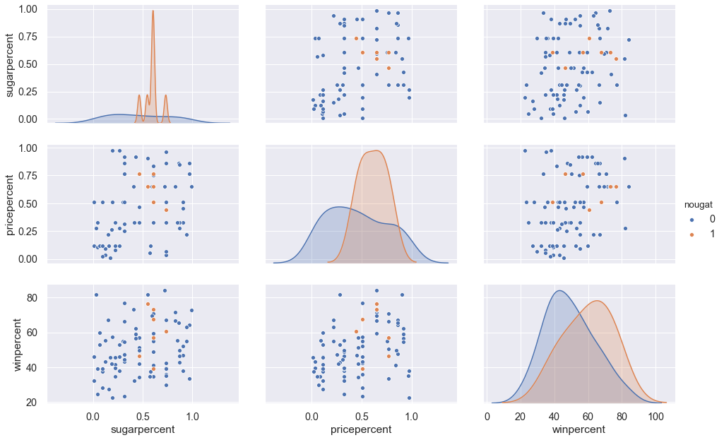
How candy characteristics co-related with sugar, price & win percentages?
03

Slide 21
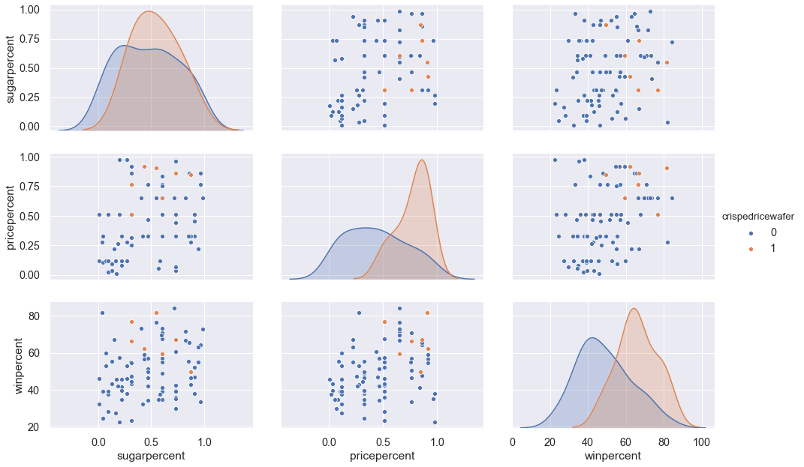
How candy characteristics co-related with sugar, price & win percentages?
03

Slide 22
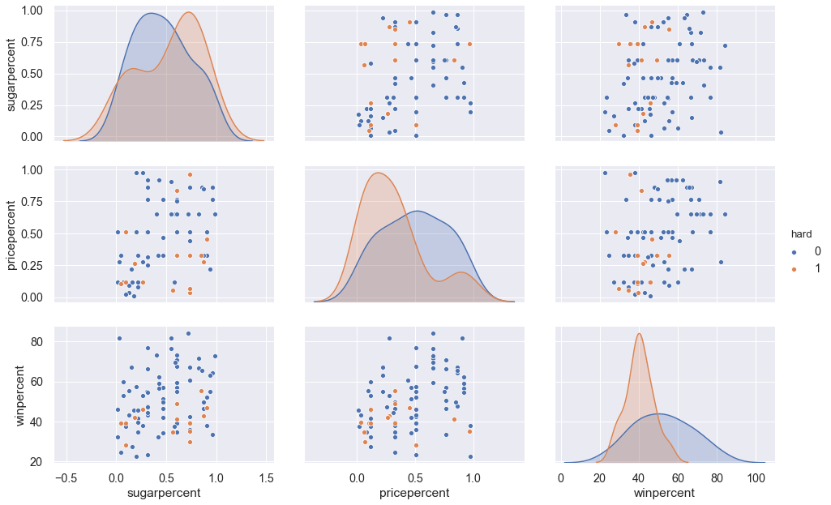
How candy characteristics co-related with sugar, price & win percentages?
03

Slide 23
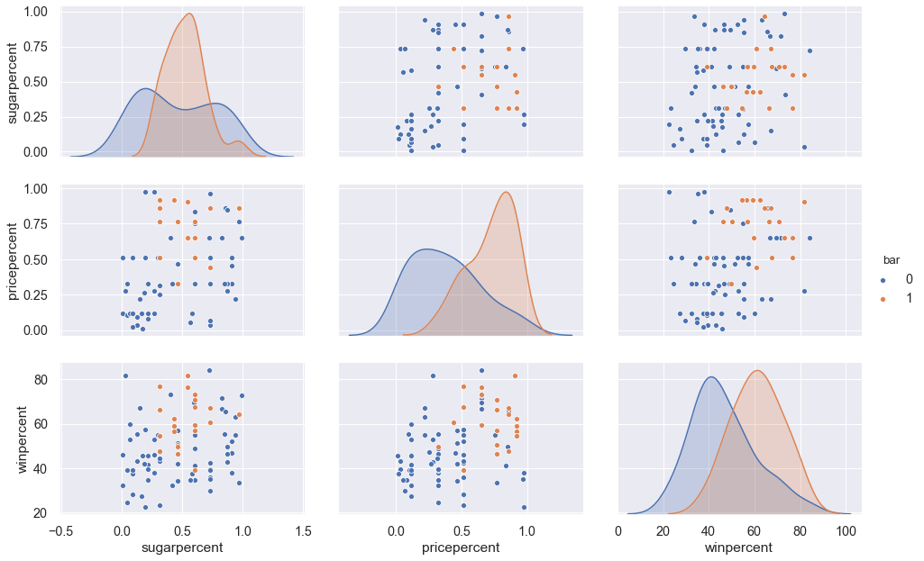
How candy characteristics co-related with sugar, price & win percentages?
03

Slide 24
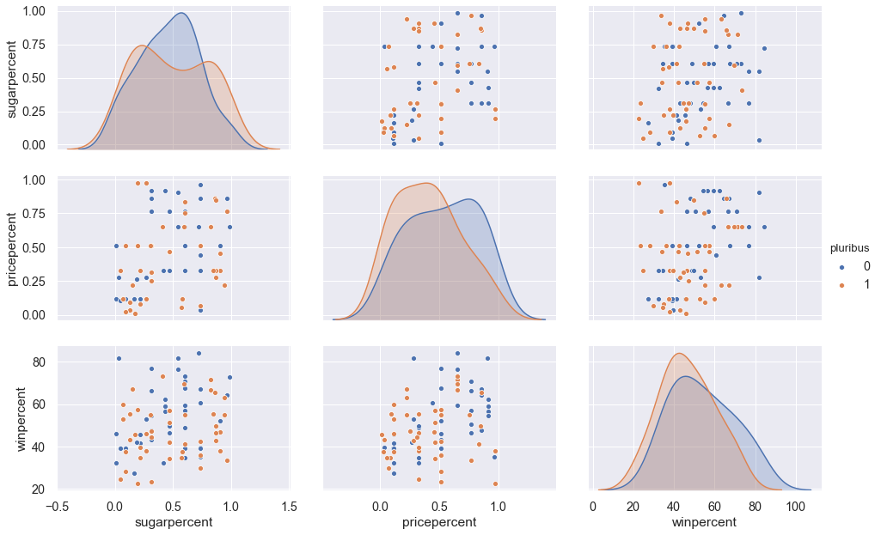
How candy characteristics co-related with sugar, price & win percentages?
03

Slide 25
CONTENT FLOW
1.
Problem Statement
Defining the Problem Statement
2.
EDA
Exploratory Data Analysis of the dataset to gain insights
3.
Predictive Model
Identify, Build & Evaluate the Models
4.
Conclusion
Insights & Recommend the best Model

Slide 26
Predictive modeling
Model Techniques
Assumptions
Data Preparation
Model Evaluation
Supervised Learning Approach – Target Variable is continuous
Winpercentage is the Targeted Variable
Regression Models:
- Linear Regression
- Decision Tree
- Random Forest
1. Target Variable should be Normally distributed
2. Explanatory Variables & Target Variable should have Linear Relationship
3. Should have no Multicollinearity
Train – Test Split
80:20 Model – Train the model on 80% of data and remaining 20% of data to test the model
Evaluation Criteria
Highest value of R2
Lowest values of:
RMSE – Root Mean Square Error
MSE – Mean Square Error
MAE – Mean Absolute Error

Slide 27
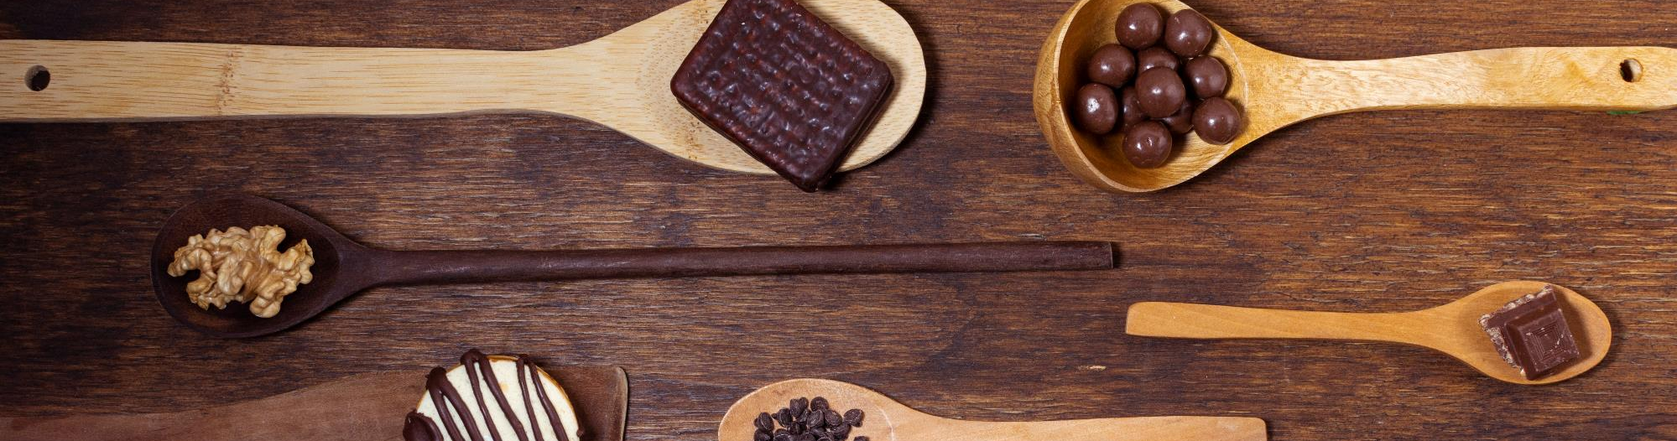
Model evaluation
LR
DT
RF
01
02
03
Linear Regression
Decision Tree
Random Forest
MAE | 7.93 | 5.98 | 4.47
MSE | 99.13 | 64.64 | 35.14
RMSE | 9.95 | 8.04 | 5.92
R2 | 0.55 | 0.71 | 0.84

Slide 28
CONTENT FLOW
1.
Problem Statement
Defining the Problem Statement
2.
EDA
Exploratory Data Analysis of the dataset to gain insights
3.
Predictive Model
Identify, Build & Evaluate the Models
4.
Conclusion
Insights & Recommend the best Model

Slide 29
conclusion
Chocolate and Peanuts / Almonds flavors are the most popular candies
Bar candies have high Win percentage and are slightly expensive
Random Forest is the best recommended fit model for predicting the Win percentage based on high R2 value and low value of RMSE out of other models – Linear Regression and Decision Tree which are on higher side of RMSE values

Slide 30

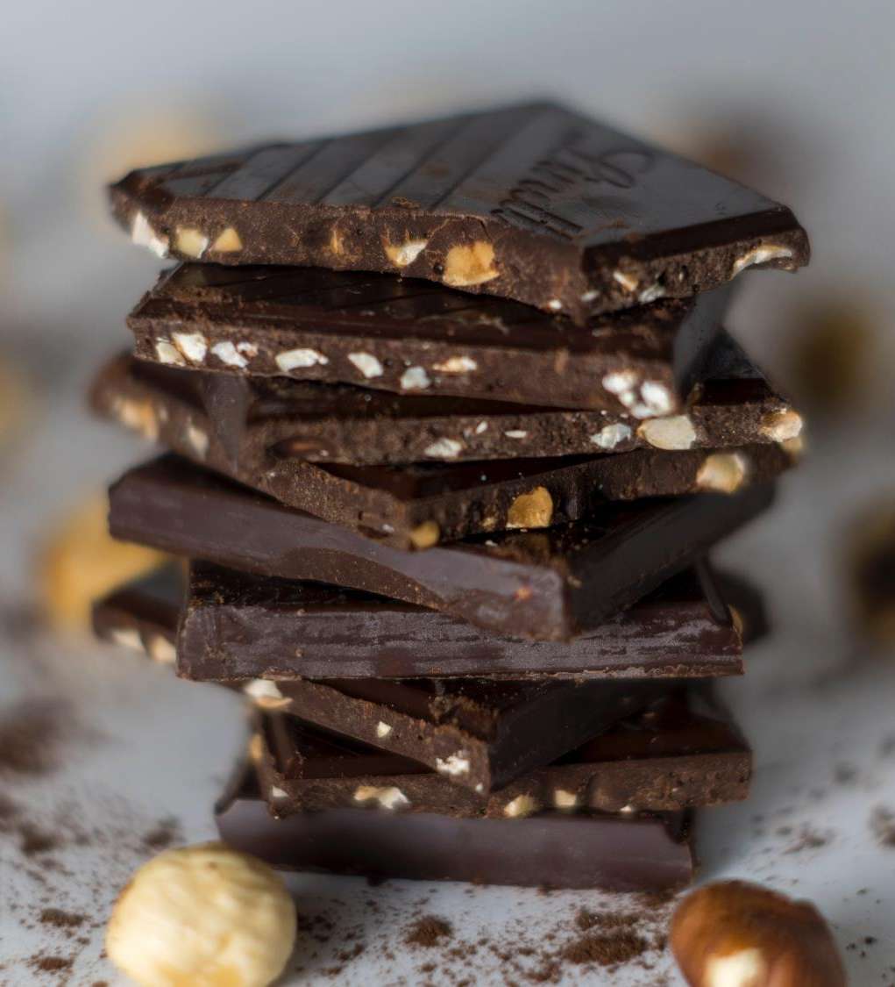
THANK YOU

